Slide 1
The Origin of eMSTO In Galactic Open Cluster From The View of Rotation Distribution
温元昊

Slide 2
Content
Background
Data Analysis
Simulation
Result
Future Work

Slide 3
Multiple Stellar Population
Single stellar population
Multiple population in old globular cluster
Multiple population in young and intermediate-age open cluster
Differential metallicity in
one cluster
Formation
Identical metallicity, differential …
Rotation
Simulation
Result
Future Work

Slide 4
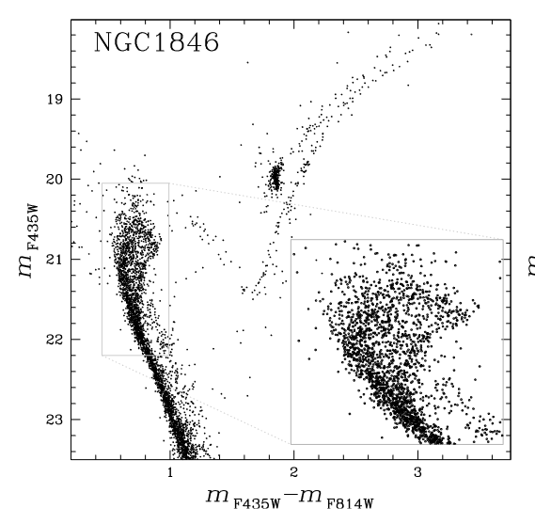
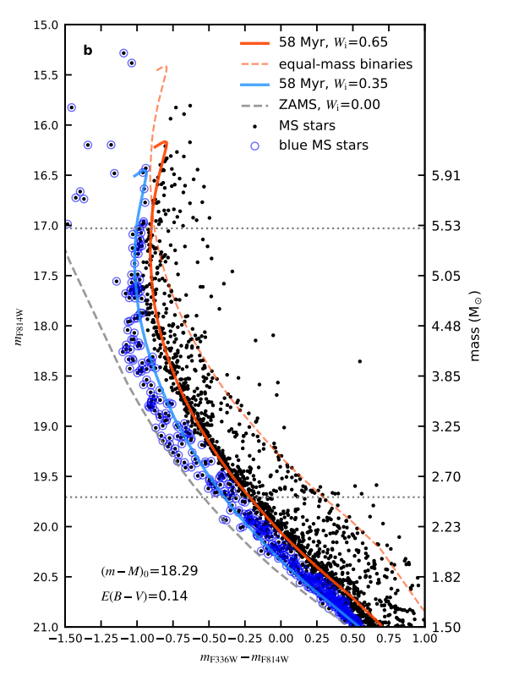
Morphology of Main Sequence
Split Main Sequence
(young OC)
Extended Main Sequence Turn-off
(young and intermediate-age OC)
Simulation
Result
Future Work

Slide 5
Origin Scenarios of eMSTO
Formation View
Rotation View
Magnetic braking or tidal braking
Second burst of star
formation
Contradicted with
morphology and
Prolonged star formation evolution of bMS &
process
rMS
Angular momentum loss in Blue-straggler star phase
……
Other reason
Binary，photometric uncertainty，differential metallicity，differential extinction，Be star……
……
ω
_{ω}2_{R}3
1
Ω =
ω
= ( )2
GM
crit
Simulation
Result
Future Work

Slide 6
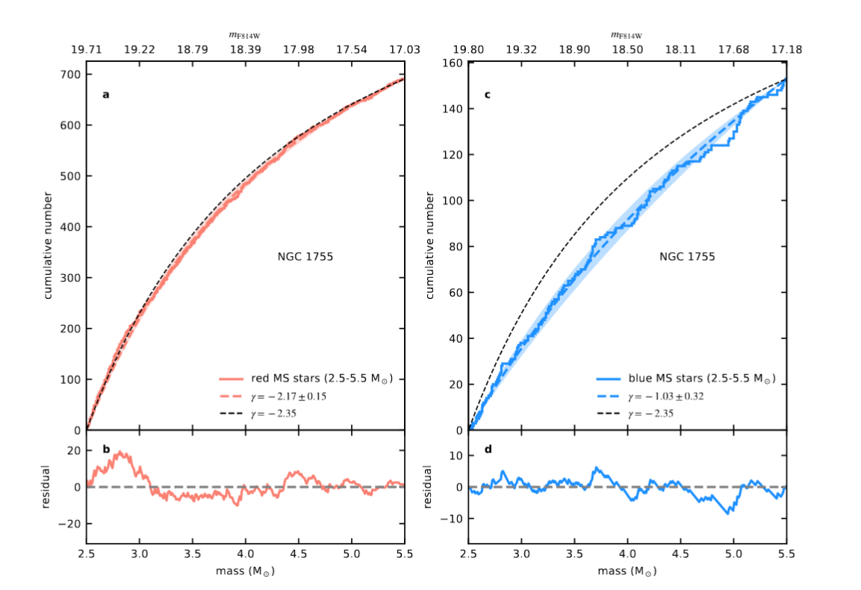
Bi-modal Mass Distribution
bMS stars more massive than 2.5 Msun are not formed by the same mechanism
Simulation
Result
Future Work

Slide 7
Star Selection
Cluster Member
Total Gaia DR3 Open Cluster Member | 435846
Cross Match With LAMOST DR10 LRS & TESS Input Catalog | 7567
PATHOS Light Curve | 4328
LAMOST Vsini | 3211
Remove binaries
Gaia DR3 VariSummary Catalog: I/358/varisum
Renormalised Unit Weight Error (RUWE)
Simulation
Result
Future Work

Slide 8
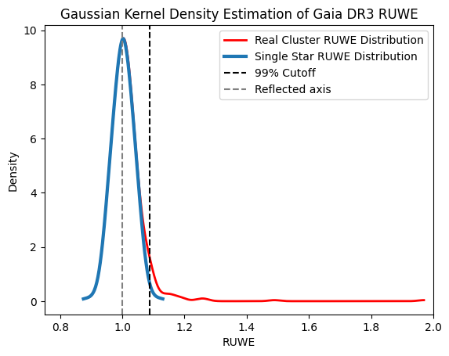
Star Selection
Red line: original Gaia DR3 RUWE distribution
Blue line: theoretical single star RUWE distribution
Satisfy both the 99th percentile line and absolute RUWE cutoff
Simulation
Result
Future Work

Slide 9
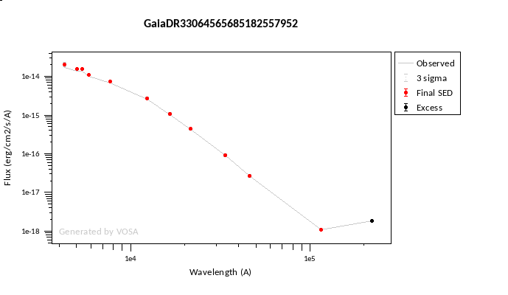
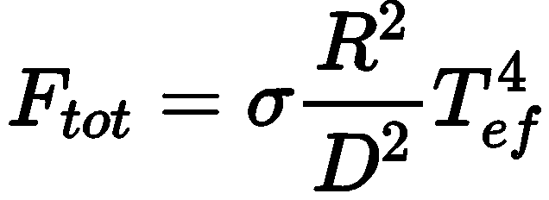
Spectral Energy Distribution
Multiband Photometry
GALEX (AIS): FUV and NUV
Tycho-2: Tycho B (BT) and Tycho V (VT)
APASS DR6 : Johnson BV
SDSS: gri bands
2MASS: JHKS bands
All-WISE: WISE1–4 bands
Simulation
Result
Future Work

Slide 10
Mass-Teff Relation
Multiband Photometry
GALEX (AIS): FUV and NUV
Tycho-2: Tycho B (BT) and Tycho V (VT)
APASS DR6 : Johnson BV
SDSS: gri bands
2MASS: JHKS bands
All-WISE: WISE1–4 bands
Simulation
Result
Future Work

Slide 11
Extinction Free CMD
Distance confirmation: photo-geometric distance from I/352/gedr3dis
Extinction calculation: 3D reddening map Bayestar19; python library dustmaps
Gaia BP, Gaia RP magnitude extinction: BEAST(Bayesian Extinction And Stellar Tool); python library dustapprox
Simulation
Result
Future Work

Slide 12
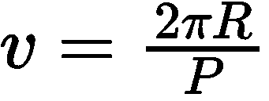
Rotation Velocity
Mechanism: rotation modulation of starspots and active regions
Method:
Autocorrelation function(ACF)
From period rotation velocity:
Simulation
Result
Future Work

Slide 13
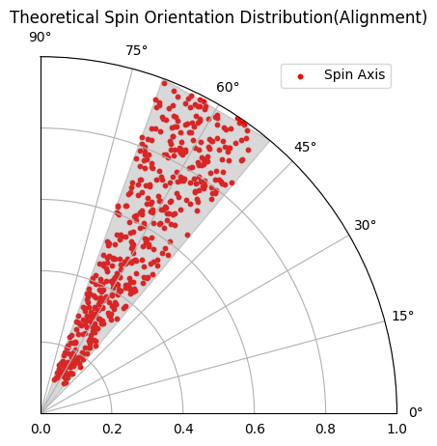
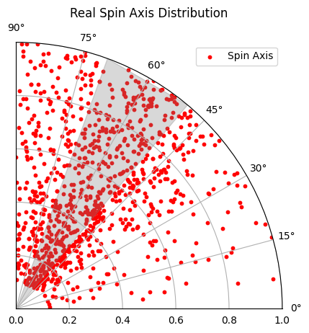
Spin Alignment Distribution
Cone Model Parameter
α: Mean inclination (ranges from 0◦ (pole-on orientation) to 90◦ (edge-on orientation))
λ: Half-angle of the inclinations spread (Same range, 0◦ corresponding to complete alignment and 90◦ representing complete isotropy)
f: Alignment Fraction
Simulation
Result
Future Work

Slide 14
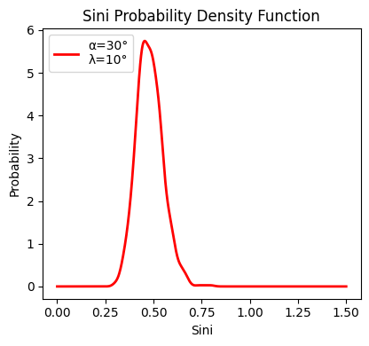
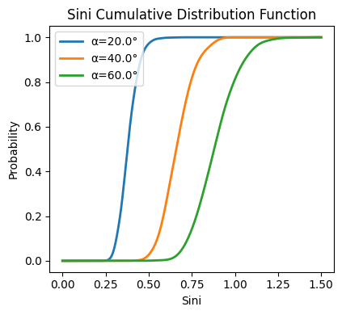
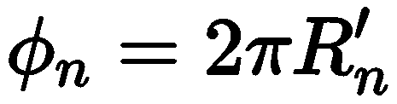
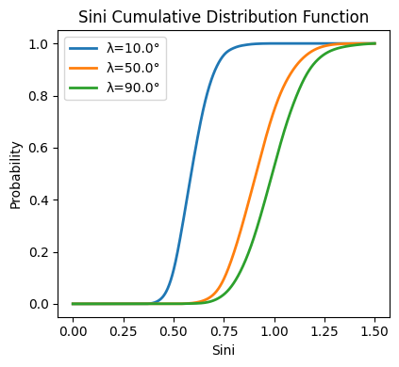
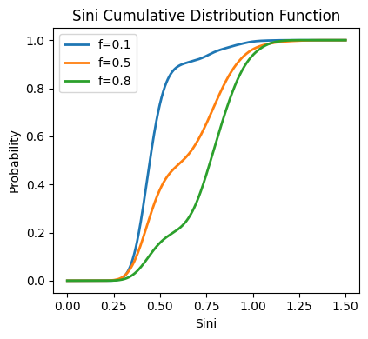
Spin Alignment Distribution
Where
Run MCMC to acquire the parameter: α, λ, f and their relation
Background | Data Analysis | Simulation | Result | Future Work

Slide 15
MESA Fitting Procedure
Synthetic evolutionary track(EEP) according to real cluster’s parameter
Extract the isochrone grids at a given age, metallicity and Ω
Synthetic population with identical rotation velocity distribution with real cluster.
Compare the difference of shape and width of eMSTO.
Simulation
Result
Future Work

Slide 16
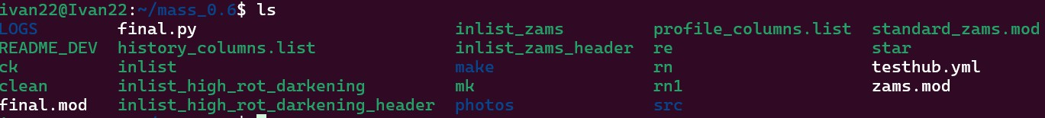



MESA Inlist Parameter setting
star_job: Basic simulation parameter and workflow eos: Stellar equation of state
kap: Stellar opacity information
control: Settings of specific physical process
Default parameter: $MESA_DIR/star/defaults Template: $MESA_DIR/star/test_suite
Simulation
Result
Future Work

Slide 17
MESA Inlist Parameter setting
Initial condition and ending condition
\star_job
new_rotation_flag = .true.
change_initial_rotation_flag = .true.
relax_initial_omega_div_omega_crit = .true.
new_omega_div_omega_crit = 0.9
relax_omega_max_yrs_dt = 1d9
num_steps_to_relax_rotation = 100
\control
initial_mass = 2.0d0
initial_z = 0.012206883460363242
xa_central_lower_limit_species(1) = 'h1'
xa_central_lower_limit(1) = 1d-3
max_age = 1.2d9
Simulation
Result
Future Work

Slide 18
MESA Inlist Parameter setting
Predictive Mixing (overshooting)
\control
use_ledoux_criterion = .true.
mixing_length_alpha = 2d0
MLT_option = 'Henyey'
alpha_semiconvection = 1d0
thermohaline_coeff = 1d0
\control
predictive_mix(1) = .true.
predictive_zone_type(1) = 'any'
predictive_zone_loc(1) = 'core'
predictive_bdy_loc(1) = 'top'
!predictive_mix(2) = .true.
!predictive_zone_type(2) = 'any'
!predictive_zone_loc(2) = 'shell'
!predictive_bdy_loc(2) = 'bottom'
Simulation
Result
Future Work

Slide 19
MESA Inlist Parameter setting
Stellar Wind
\control
! cool_wind_full_on_T = 8d3
cool_wind_RGB_scheme = 'Dutch'
cool_wind_AGB_scheme = 'Dutch'
! RGB_to_AGB_wind_switch = -1
! Reimers_scaling_factor = 1d0
! hot_wind_full_on_T = 1.2d4
hot_wind_scheme = 'Dutch'
! Vink_scaling_factor = 1d0
Dutch_scaling_factor = 1d0
\control
max_mdot_redo_cnt = 200
min_years_dt_for_redo_mdot = 1d-5
surf_omega_div_omega_crit_limit = 0.99
surf_omega_div_omega_crit_tol = 0.01d0
rotational_mdot_boost_fac = 1d10
rotational_mdot_kh_fac = 1d10
mdot_revise_factor = 1.1
Simulation
Result
Future Work

Slide 20
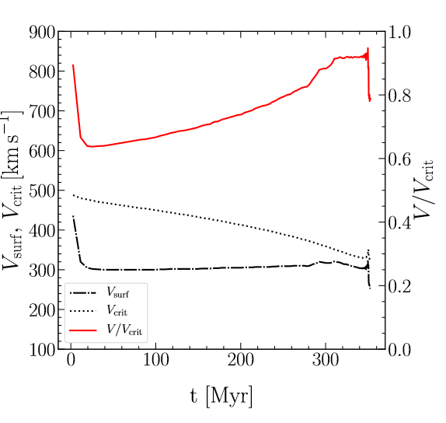
Synthetic EEP
Ω changes freely with evolution due to the different rate of variation of ω and ω_crit !
Pre-simulation
Empirical parameter setting solution
Running script for single mass and metallicity
Rule out the special event in evolutionary
Simulation
Result
Future Work

Slide 21
Extraction of Isochrones
Bolometric Correction from L to Gbp Grp (PARSEC)
Interpolation of magnitude at a given age and Ω
Simulation
Result
Future Work

Slide 22
Synthetic Population
Theoretical population：resample from the isochrones basing on the real Ω distribution from a normal distribution
Metallicity issue：
Fitting the empirical effect of differential metallicity on eMSTO
Resample function: metallicity KDE
Simulation
Result
Future Work

Slide 23
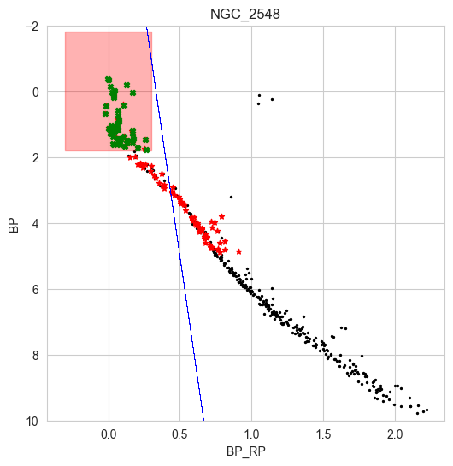
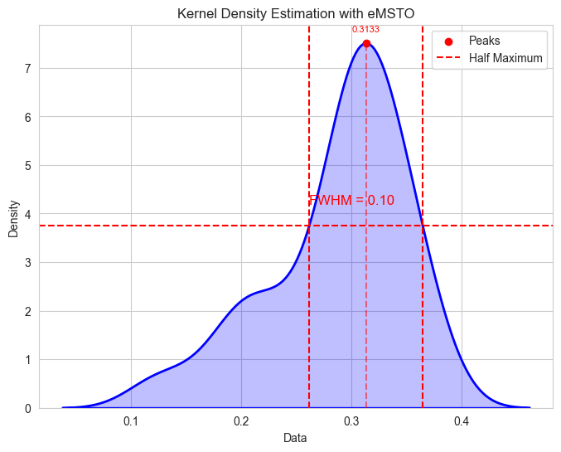
eMSTO of NGC 2548
Simulation
Result
Future Work

Slide 24
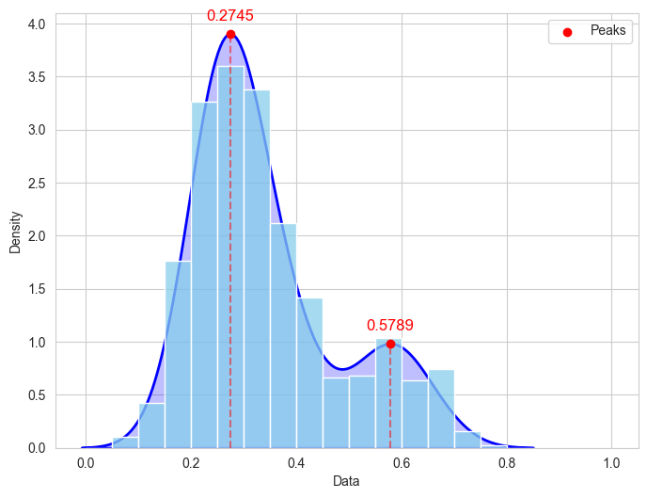
Rotation Velocity Distribution
The two peak distribution is consistent with existing scenarios from Wang et.al.(2022) simulation
Simulation
Result
Future Work

Slide 25
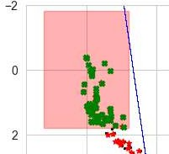

The effect of Inclination
Rough calculation tells that different inclination’s effect is NOT negligible
Simulation
Result
Future Work

Slide 26
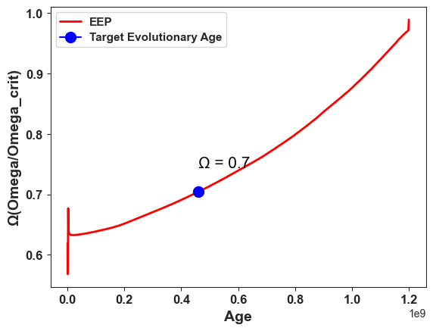
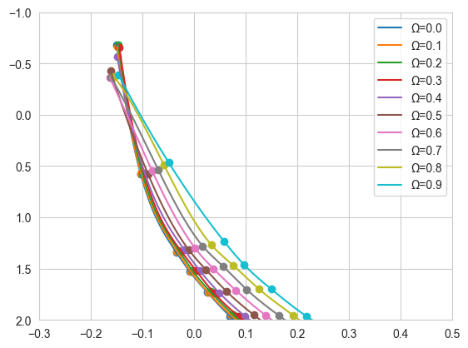
Isochrones Grid For NGC_2548
Simulation
Result
Future Work

Slide 27
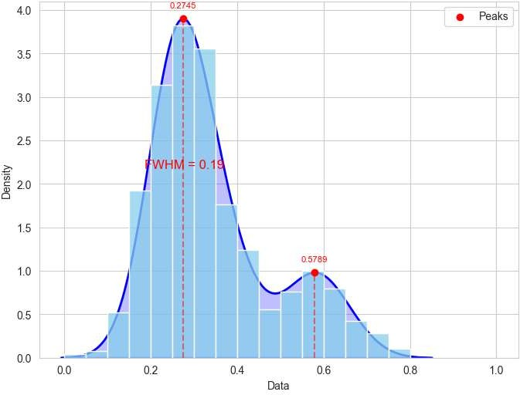
Range of Rotation Velocity Distribution
Vsini data from LAMOST MRS spectra may help improving the eMSTO width calculation

Slide 28
Miss Confirmation of Star Rotation Velocity
Magnitude estimation:
𝑣𝑠𝑖𝑛𝑖 · P 2𝜋𝑅
𝑠𝑖𝑛𝑖 =
Sini will have a meaningful value only when
P is small enough(<0.3day)
Vsini is small enough(<100km/s)
Instrument limit

Slide 29
Thanks for listening

